Slide 1
GEOweb PROPERTY VIEWER
DESIGNING FOR SIMPLICITY

Slide 2
www.geoweb.dnv.org/properties

Slide 3
CONCLUSION
Very successful development process
Very successful beta application
Fast
Lightweight
Mobile friendly
Single code base
Confidence for future development

Slide 4
AGENDA
SOME HISTORY
CHALLENGES
DESIGN & BUILD
SUCCESSES & DIFFICULTIES
WHAT’S NEXT
For context
Why?
Not just nerdy stuff
Important!
The world
QUESTIONS
Crickets?

Slide 5
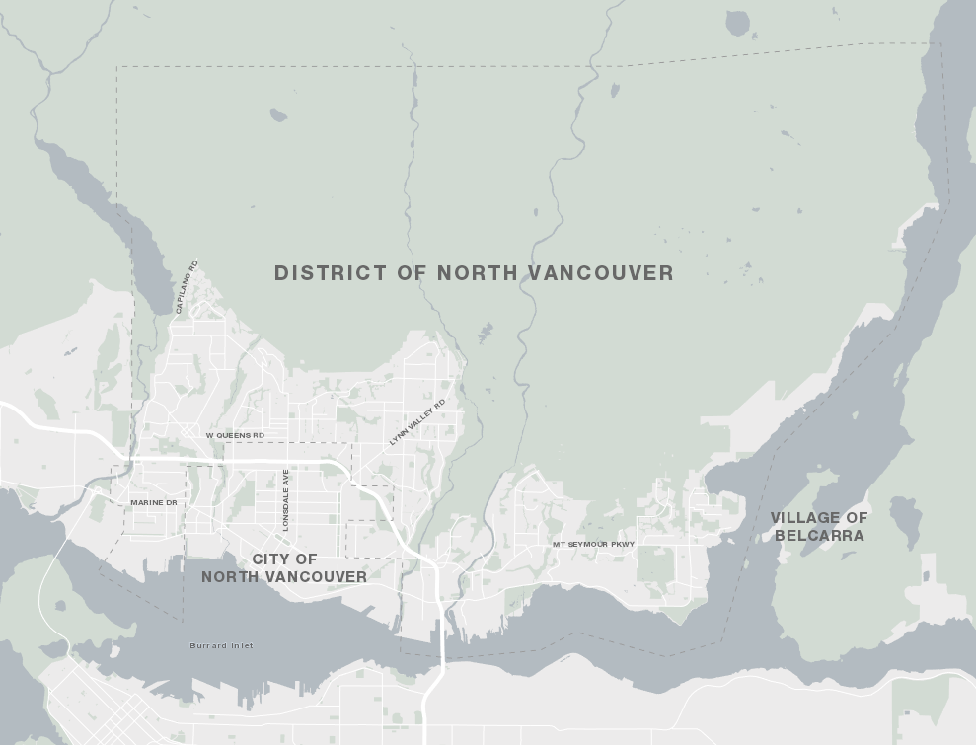
The DISTRICT of NORTH VANCOUVER
Around 85,000 Residents
GIS Section = 3 Analysts + 1 Coordinator + 1 Manager (Biz Systems & GIS)
Dev Team = 2 Application Developers + 1 Manager

Slide 6
HISTORY
2001 ArcIMS
GIS launches GEOweb (geoweb.dnv.org)
P.I.E., Plans & Drawings
2009 Flex/Flash
GEOweb rebuild, launch of five specialized apps
Open Data
2011 Flex/Flash v2
Dedicated GIS Application Developers
Backend updates
2014 HTML5
Need for mobile support, a better experience
GIS awareness is ubiquitous
New web mapping paradigm
Launch of GEOtools (internal)
Mature technology

Slide 7
CHALLENGES
PROPERTIES HAZARDS PROJECTS SOLAR HISTORY
Evolving user needs
Flash
Applications have deviated
Better integration needed with DNV web
Dated
Need a plan for future development

Slide 8
CHALLENGES
Evolving user needs
“Why doesn’t this work on my phone?”

Slide 9
CHALLENGES
PROPERTIES HAZARDS PROJECTS SOLAR HISTORY
Evolving user needs
Flash
Applications have deviated
Better integration needed with DNV web
Dated
Need a plan for future development

Slide 10
GOALS
Device Agnostic
Fast
Better maps
Clear and Concise
More property-related info
Easy to maintain, scalable, future proof

Slide 11
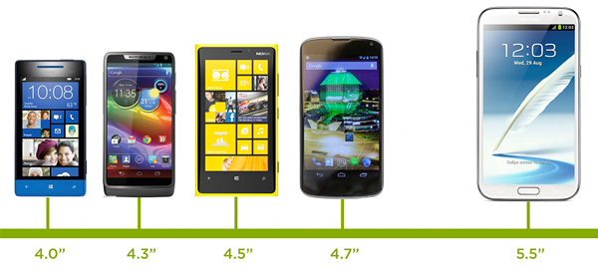
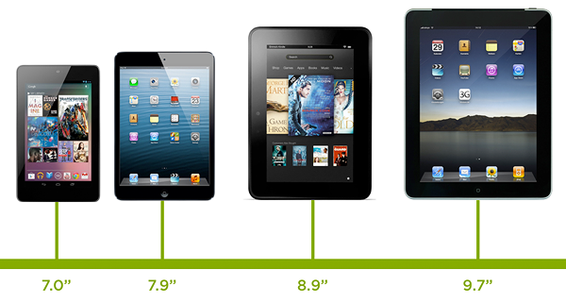
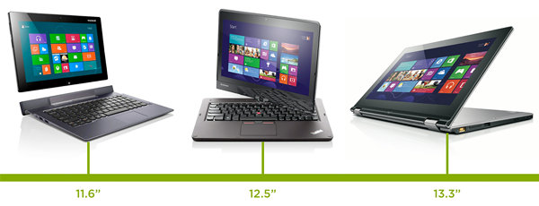
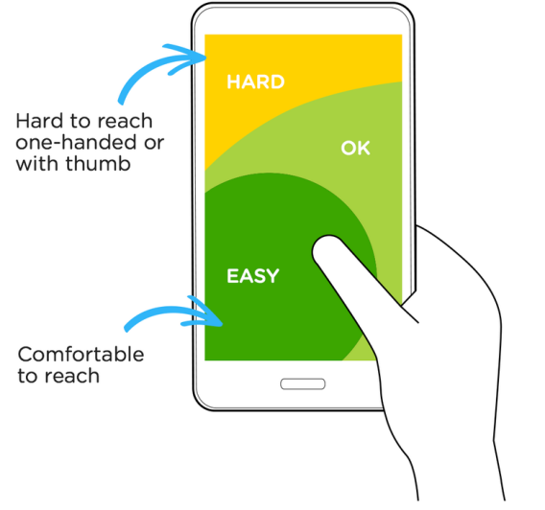
USABILITY
LUKEW Ideation + Design | www.lukew.com

Slide 12
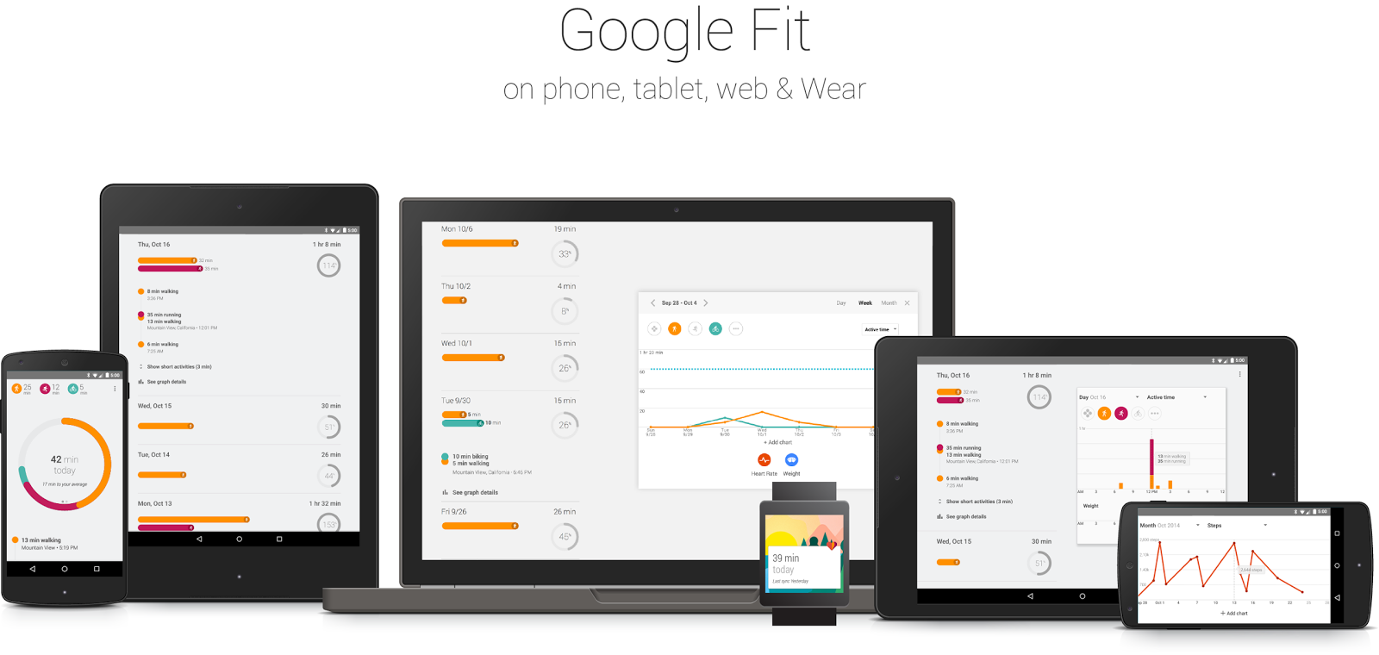
USABILITY

Slide 13
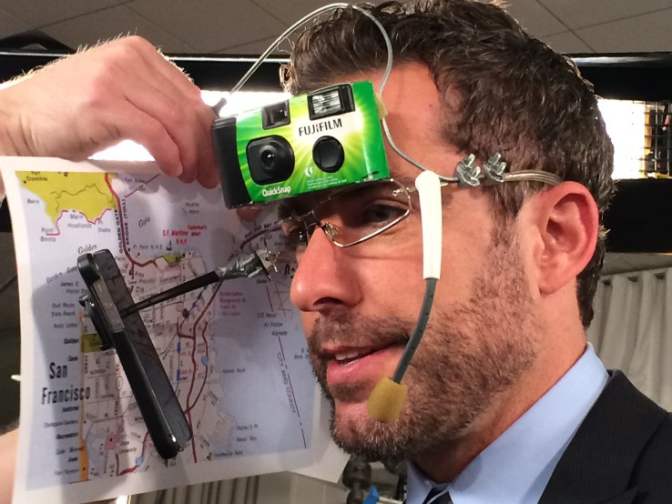
USABILITY
LUKEW Ideation + Design | www.lukew.com

Slide 14
USABILITY
Conway’s Law
“Organizations which design systems ... are constrained to produce designs which are copies of the communication structures of these organizations.”
— M. Conway, 1968

Slide 15
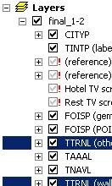
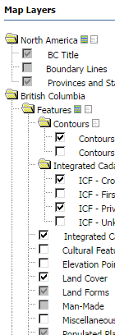
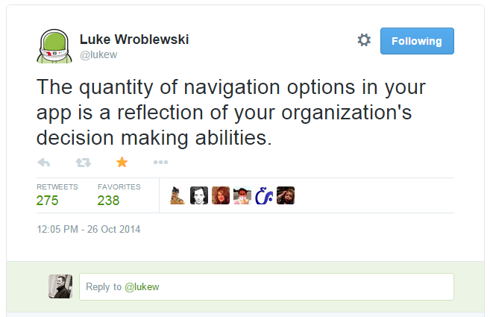
USABILITY
Conway’s Law
“Organizations which design systems ... are constrained to produce designs which are copies of the communication structures of these organizations.”
— M. Conway, 1968

Slide 16
USABILITY
Conway’s Law
“Organizations which design systems ... are constrained to produce designs which are copies of the communication structures of these organizations.”
— M. Conway, 1968

Slide 17
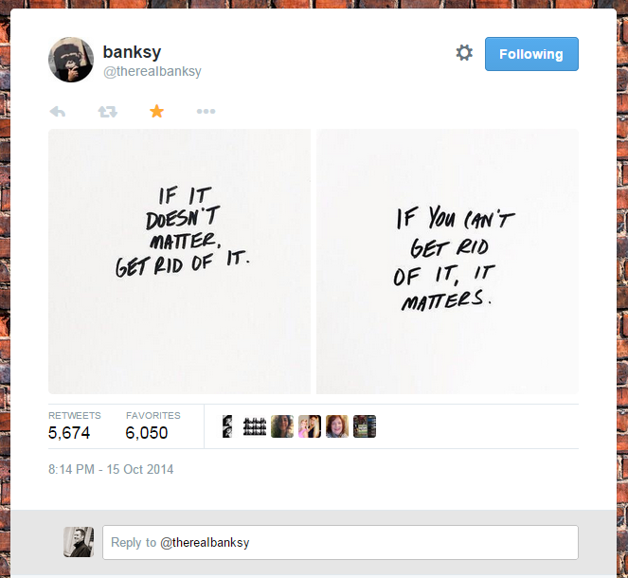
DESIGN & BUILD
PHASE ONE – CONTENT

Slide 18
DESIGN & BUILD
PHASE ONE – CONTENT
Not starting from scratch
5+ years of user metrics
Basemaps
Layers
Tools
Search Methods

Slide 19
DESIGN & BUILD
PHASE ONE – CONTENT

Slide 20
DESIGN & BUILD
PHASE ONE – CONTENT
Popular! Keep these!
Ditch these.

Slide 21
DESIGN & BUILD
PHASE ONE – CONTENT
Popular! Keep these!
Basemap
Ditch these.

Slide 22
DESIGN & BUILD
PHASE TWO - MAPS
Improve the content & look of our maps
Clear symbology
Clear typography, better labelling

Slide 23
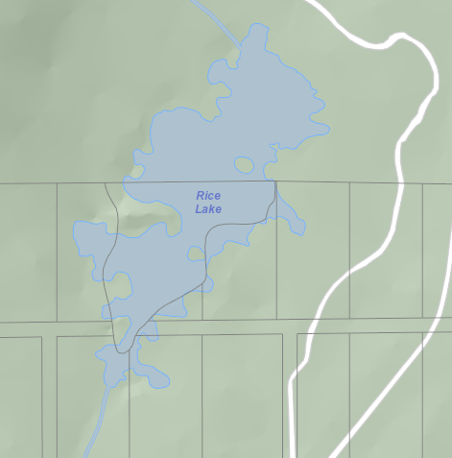
DESIGN & BUILD
PHASE TWO - MAPS
Improve the content & look of our maps
Clear symbology
Clear typography, better labelling

Slide 24
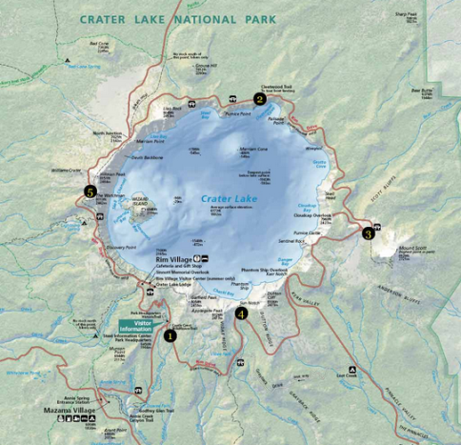
DESIGN & BUILD
PHASE TWO - MAPS
Improve the content & look of our maps
Clear symbology
Clear typography, better labelling

Slide 25
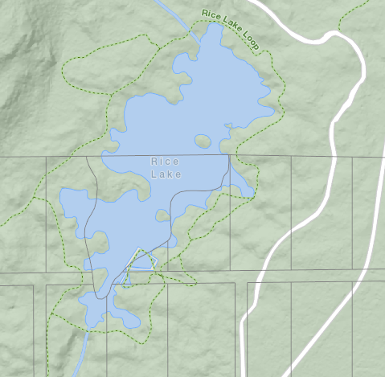
DESIGN & BUILD
PHASE TWO - MAPS
Improve the content & look of our maps
Clear symbology
Clear typography, better labelling

Slide 26
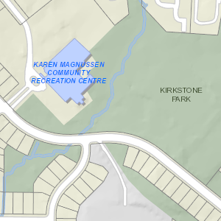
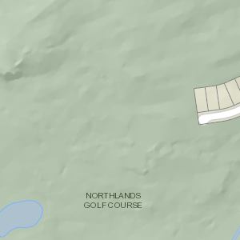
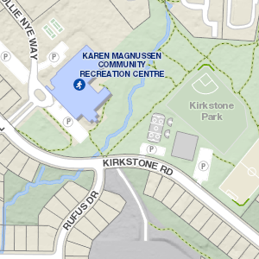
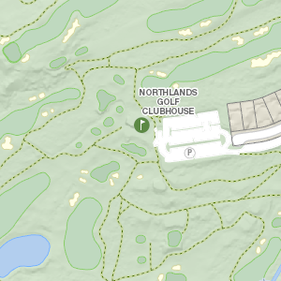
DESIGN & BUILD
PHASE TWO - MAPS

Slide 27
DESIGN & BUILD
PHASE THREE – TECH RESEARCH
One Developer, three months
Client-side only; Server is all good
Maps
Map APIs
Frameworks

Slide 28
DESIGN & BUILD
PHASE THREE – TECH RESEARCH
Many well supported libraries:
Map Engines
Esri Javascript API
Leaflet
Mapbox
OpenLayers

Slide 29
DESIGN & BUILD
PHASE THREE – TECH RESEARCH
Many well supported libraries:
Map Engines
Esri Javascript API
Leaflet
Mapbox
OpenLayers

Slide 30
DESIGN & BUILD
PHASE THREE – TECH RESEARCH
Many well supported libraries:
HTML5 Frameworks
Bootstrap
Foundation
Boilerplate

Slide 31
DESIGN & BUILD
PHASE THREE – TECH RESEARCH
Many well supported libraries:
HTML5 Frameworks
Bootstrap
Foundation
Boilerplate

Slide 32
DESIGN & BUILD
PHASE THREE – TECH RESEARCH
Many well supported libraries:
Javascript Architecture
Ember
Backbone
Angular JS

Slide 33
DESIGN & BUILD
PHASE THREE – TECH RESEARCH
Many well supported libraries:
Javascript Architecture
Ember
Backbone
Angular JS

Slide 34
DESIGN & BUILD
PHASE THREE – TECH RESEARCH
Many well supported libraries:
Javascript Architecture
Ember
Backbone
Angular JS

Slide 35
DESIGN & BUILD
PHASE FOUR – ALL TOGETHER NOW
Map Engine
Leaflet
HTML5
Bootstrap
Javascript
Angular JS

Slide 36
DESIGN & BUILD
PHASE FOUR – ALL TOGETHER NOW
Map Engine
Leaflet
HTML5
Bootstrap
Javascript
Angular JS
Foundation
ArcGIS for
Server
ArcGIS for
Desktop
ArcGIS for Mobile
Collector for ArcGIS

Slide 37
DESIGN & BUILD
PHASE FOUR – ALL TOGETHER NOW
Map Engine
Leaflet
HTML5
Bootstrap
Javascript
Angular JS
Esri Leaflet on
Foundation
ArcGIS for
Server
ArcGIS for
Desktop
ArcGIS for Mobile
Collector for ArcGIS

Slide 38
GOALS
Device Agnostic
Fast
Clear and Concise
Better maps
More property-related info
Easy to maintain, scalable, future proof
HAZARDS & SOLAR

Slide 39
PAUSE, REGROUP
Identified problems
Set our goals
Researched our users’ needs
Built better maps
Researched the technology
Ready to build an app

Slide 40
DESIGN & BUILD
SCRUM DEVELOPMENT MODEL
PRODUCT BACKLOG
CODE AND TEST
RELEASE PRODUCT INCREMENT
SPRINT BACKLOG
Daily stand-up meeting
Repeat every two weeks

Slide 41
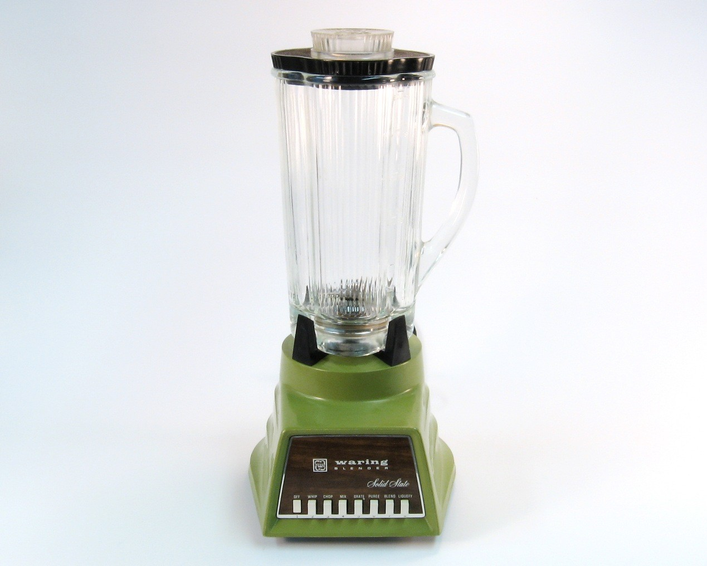
DESIGN & BUILD
SIX WEEKS

Slide 42
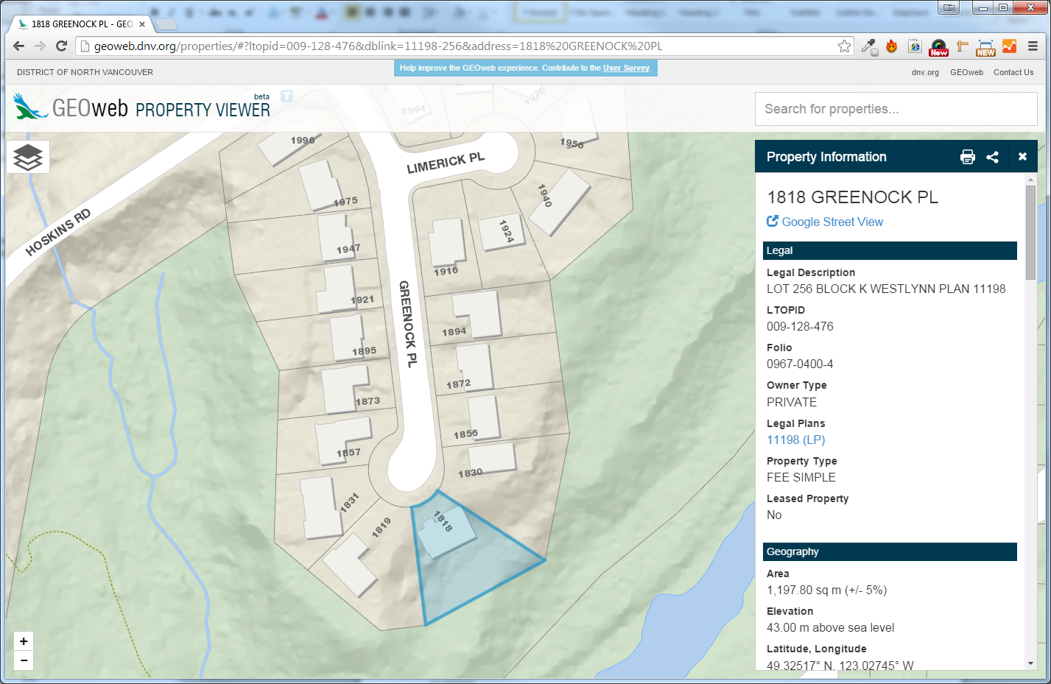
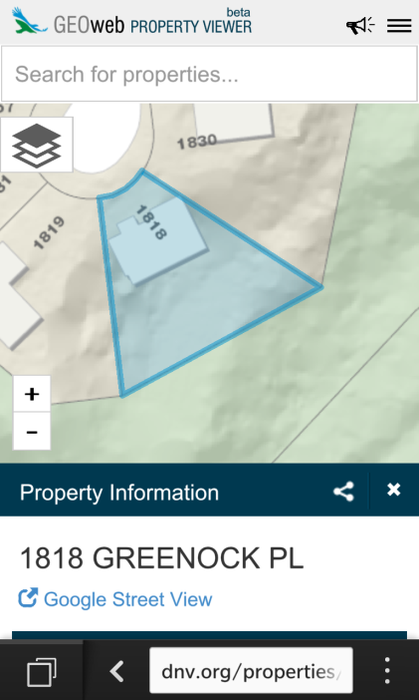
PROPERTY VIEWER BETA

Slide 43
WHERE WE’RE AT
App was launched in beta in July 2014
Promoted feedback!
Online survey
Twitter
Emails
Phone calls

Slide 44
USER FEEDBACK
Very positive; always includes helpful criticism

Slide 45
USER FEEDBACK
Very positive; always includes helpful criticism

Slide 46
USER FEEDBACK

Slide 47
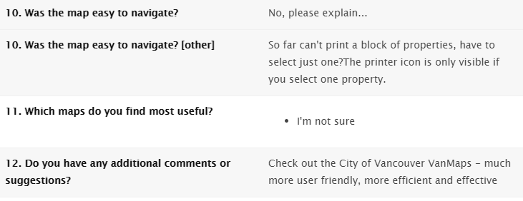
USER FEEDBACK

Slide 48
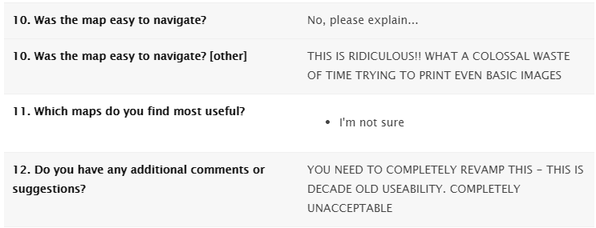
USER FEEDBACK

Slide 49
USER FEEDBACK

Slide 50
DIFFICULTIES
Browser compatibility
Consistency on all form factors
Printing
Dealing with Open Source projects
Things change quickly
Bugs

Slide 51
SUCCESSES
Single code base
Confidence in development plan
Happy users
Realtors
Roofers
Assessors
DNV Utilities
DNV Construction

Slide 52
WHAT’S NEXT
Measure tool
SEO
GEOtools HTML5
Additional focused apps
Developers app is up next
Integration into dnv.org
DNV on GitHub

Slide 53
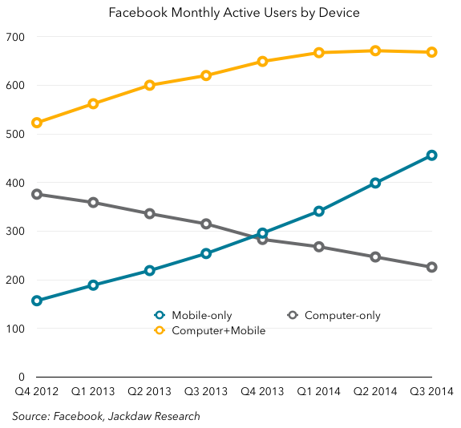

Slide 54
GEOweb PROPERTY VIEWER
QUESTIONS?
Andrew Durnin
adurnin@dnv.org
@durnin
@nvandistrict

